Slide 1
Random Variables and Expectation

Slide 2
Random Variables
A random variable X is a mapping from a sample space S to a target set T, usually N or R.
Example: S = coin flips, X(s) = 1 if the flip comes up heads, 0 if it comes up tails
Example: S = Harvard basketball games, and for any game s∈S, X(s) = 1 if Harvard wins game s, 0 if Harvard loses.
These are examples of Bernoulli trials: The random variable has the values 0 and 1 only.

Slide 3
More Random Variables
Example: S = sequences of 10 coin flips, X(s) = number of heads in outcome s. E.g. X(HTTHTHTTTH) = 4.
Example: S = Harvard basketball games, X(s) = number of points player LR scored in game s.

Slide 4
Probability Mass Function
For any x∈T, Pr({s∈S: X(s) = x}) is a well defined probability. (Min 0, max 1, sum to 1 over all possible values of x, etc.)
Usually we just write Pr(X=x).
Similarly we might write Pr(X<x)
Example: S = Roll of a die, X(s) = number that comes up on roll s. Pr(X=4) = 1/6.
Pr(X<4) = ½.

Slide 5
Probability Mass Function
Example: S = result of rolling a die twice
X(s) = 1 if the rolls are equal
X(s) = 0 if the rolls are unequal
Pr(X=0) = 5/6
Pr(X=1) = 1/6.

Slide 6
Probability Mass Function
Example: S = sequences of 10 coin flips, X(s) = number of heads in outcome s. Then Pr(X=0) = 2⁻¹⁰ = Pr(X=10), and by a previous calculation, Pr(X=5) ≈ .25

Slide 7
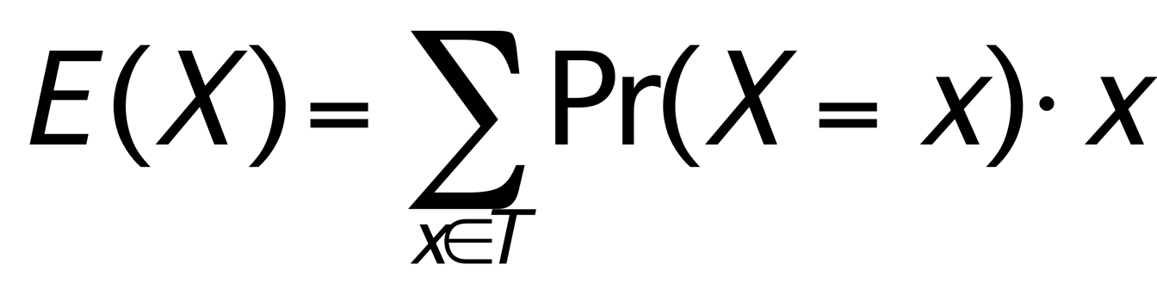
Expectation
The Expected Value or Expectation of a random variable is the weighted average of its possible values, weighted by the probability of those values.

Slide 8
Expectation, example
If a die is rolled three times, what is the expected number of common values?
That is, 464 would have 2 common values; 123 would have 1.
Pr(X=1) = 6∙5∙4/6³ = 20/36
Pr(X=3) = 6/6³ = 1/36
Pr(X=2) = 1-Pr(X=1)-Pr(X=3) = 15/36
E(X) = (20/36)∙1 + (15/36)∙2 + (1/36)∙3 ≈ 1.47

Slide 9
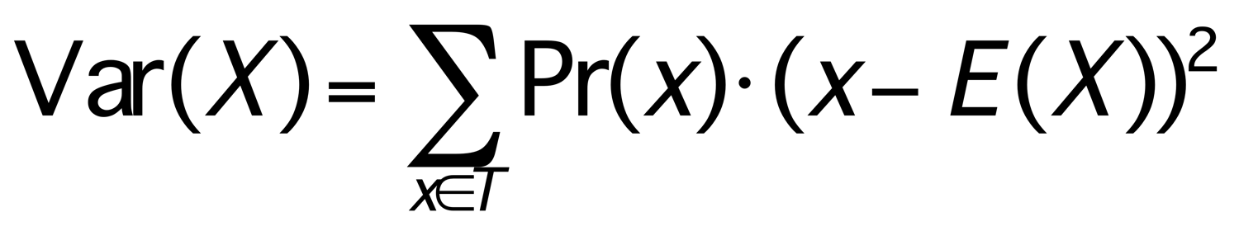
Variance
The expected value E(X) of a random variable X is also called the mean.
The variance of X is the expected value of the random variable (x-E(X))², the expected value of the square of the difference from the mean. That is,
Variance is always positive, and measures the “spread” of the values of X.

Slide 10
Same mean, different variance
⅓
Low variance
⅕
High variance
-2 -1 0 1 2

Slide 11
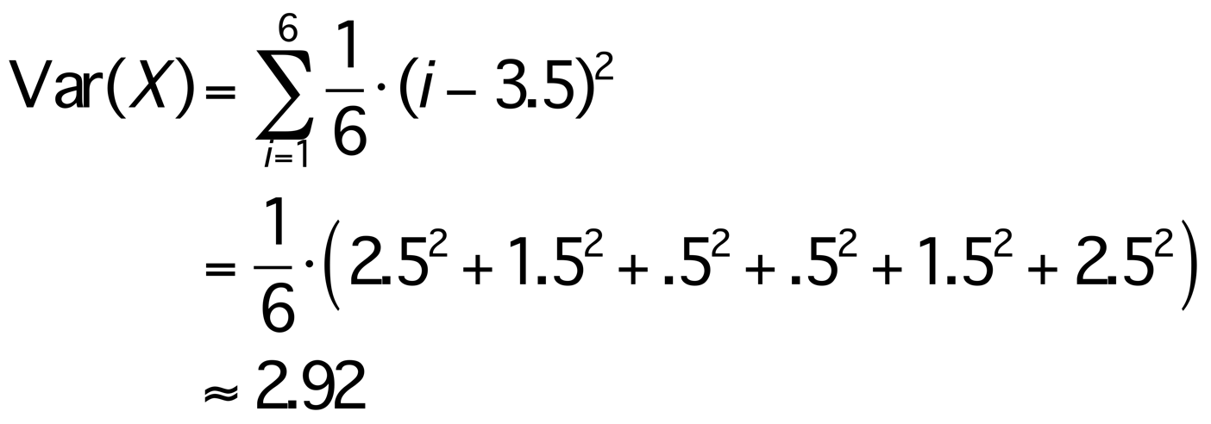
Variance Example
Roll one die, X can be 1, 2, 3, 4, 5, or 6, each with probability 1/6. So E(X) = 3.5, so

Slide 12
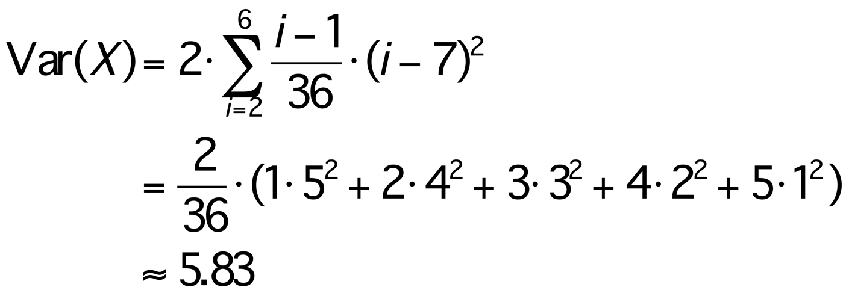
Variance Example
Roll two dice and add them. There are 36 outcomes, and X can be 1, 2, …, 12. But the probabilities vary.
So E(X) = 7 and
x | 2 | 3 | 4 | 5 | 6 | 7 | 8 | 9 | 10 | 11 | 12
Pr(x) | 1/36 | 2/36 | 3/36 | 4/36 | 5/36 | 6/36 | 5/36 | 4/36 | 3/26 | 2/36 | 1/36

